Slide 1


Session 1 AVR I/O Programming
By : Ahmad Hazem

Slide 2
References
The AVR Microcontroller and embedded system using assembly and c programming languages https://drive.google.com/file/d/11oi0zvrlObdtv1gIBRDPmfwNYbf-02Qp/view?usp=sharing
The electronic wings ATMEGA32 : https://www.electronicwings.com/avr-atmega/inside
YouTube videos: https://www.youtube.com/watch?v=pz2xl9tJo0o&list=PLhx4zaYkEjI8C2N7DgIn8Ce75qM0jb1nY

Slide 3

What is the difference between Microprocessor and Microcontroller?

Slide 4
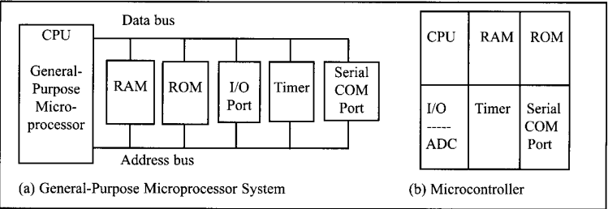

Slide 5
Fast Revision
RAM(Random Access Memory) | ROM (Read only Memory) | I/O Ports | Timers | Serial COM ports
Volatile Memory Holds current instruction used, and data used | Non-volatile Memory. Holds instructions, and constants to start up the device | Ports that are used to allow peripherals connect with the microprocessor / microcontroller | Acts as the clock for either microprocessor / microcontroller | Communication peripherals ports that allow more than microprocessor / microcontroller communicate with each other

Slide 6

Data Storage

Slide 7
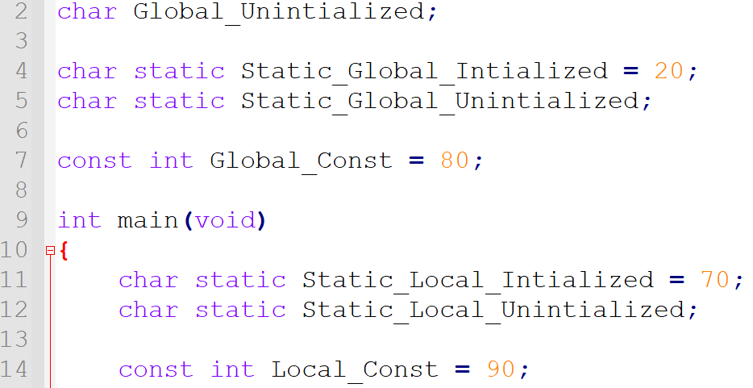

Slide 8
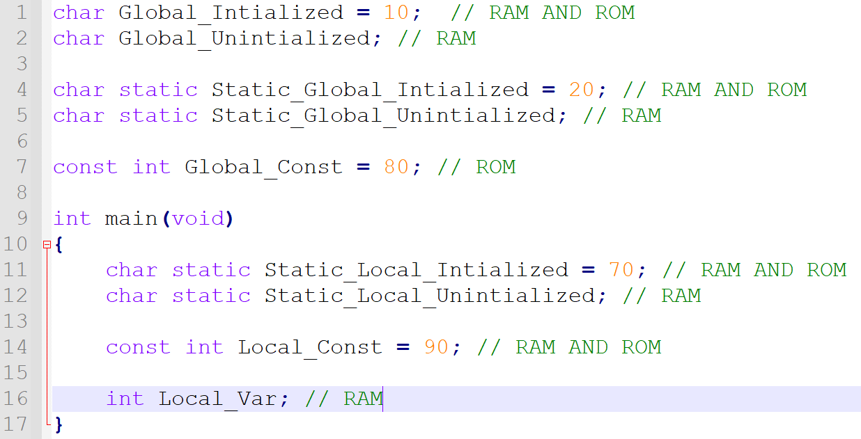

Slide 9
Program loading stages

Slide 10
Development Phase
Building Phase
Debugging Phase and run time
Profiling Phase
Loading Phase

Slide 11
Building Phase
.c (C file)
.i (Intermediate file)
.asm (Assembly file)
. Hex (Hex file)
.o (object file)

Slide 12

What is the difference between AVR and ARM?

Slide 13
Comparison between ARM and AVR
AVR (Advanced virtual RISC)
ARM (Advanced RISC Machine)
AVR used only as Microcontroller
AVR has low processing power
Only specific OS (Operating Systems) can be installed such as Free RTOS
less RAM/ROM Used in AVR
AVR is cheap and effective
ARM can be both used as Microcontroller or as Microprocessor
ARM has high Processing power
Any OS (Operating Systems) can be installed on ARM based machine
More memory in ARM
ARM is High speed and Costly

Slide 14
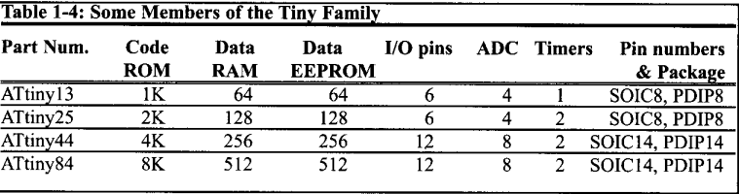
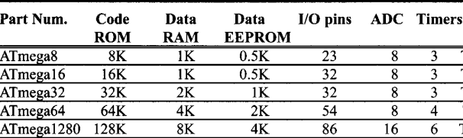
ATMEGA/ ATINY AVR FAMILY

Slide 15
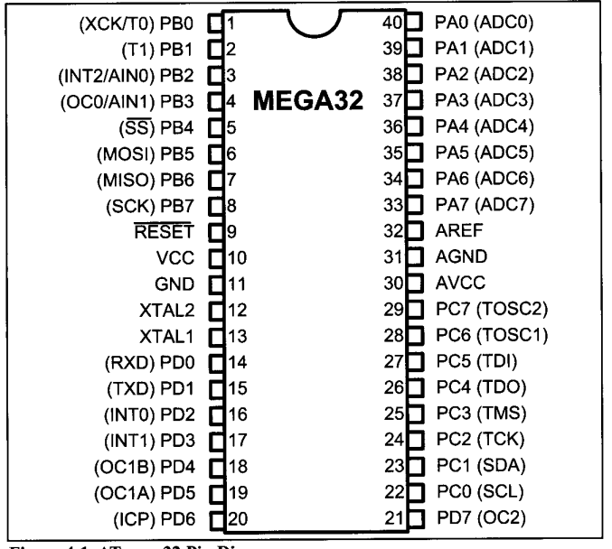
ATMEGA32
It consists of 40 pins , including 32 pins for I/O programming.
Each of the 32 pins are divided between 4 PORTS
1- PORTA (PA0 to PA7)
2- PORTB (PB0 to PB7)
3- PORTC (PC0 to PC7)
4- PORTD (PD0 TO PD7)

Slide 16
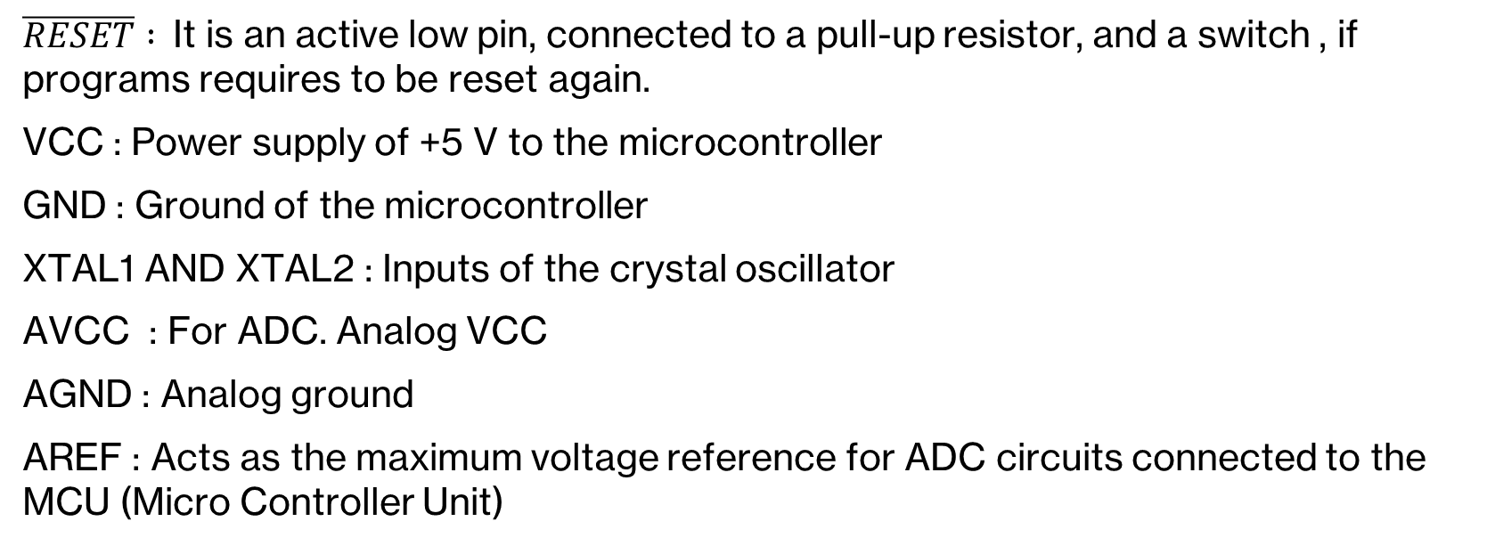
ATMEGA32 PINS
$\overline{RESET} :$It is an active low pin, connected to a pull-up resistor, and a switch , if programs requires to be reset again.
VCC : Power supply of +5 V to the microcontroller
GND : Ground of the microcontroller
XTAL1 AND XTAL2 : Inputs of the crystal oscillator
AVCC : For ADC. Analog VCC
AGND : Analog ground
AREF : Acts as the maximum voltage reference for ADC circuits connected to the MCU (Micro Controller Unit)

Slide 17
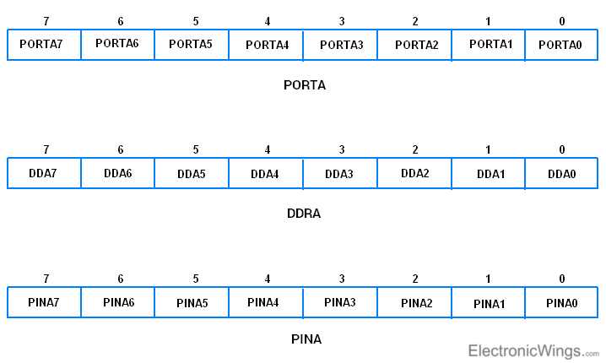
I/O Port Registers
Data register PORTx
Data direction register DDRx
Input pins address register PINx
Where x can be A, B, C, or D depending on which port is being addressed.

Slide 18
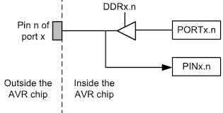

Slide 19
Data Direction Registers (DDRx)
These are 8-bit registers.
These are used to configure the pins of the ports as input or output.
Writing a one to the bits in this register sets those specific pins as output pins.
Writing a zero to the bits in this register sets those specific pins as input pins.
All bits in these registers can be read as well as written to.
The initial value of these bits is zero.

Slide 20
Example (Data Direction Registers)
DDRD = 0XEA = 0b11101010 so Pin 0, Pin 2, Pin 4 act as inputs on port D, while Pin 1, Pin 3, Pin 5 , Pin 6 , Pin 7 act as outputs in port D.
DDRB = 0x11 = ??
DDRA = 0xB2 = ??

Slide 21
Data Registers (PORTx)
These are 8-bit registers.
These are used to put the pins of the ports in a logic HIGH or logic LOW state.
Writing a one to the bits in this register puts a HIGH logic (+5V) on those pins.
Whereas writing a zero to the bits in this register puts a LOW logic (0V) on those pins.
All bits in these registers can be read as well as written to.
The initial value of these bits is zero.

Slide 22
Example
PORTD = 0x55 = 0b01010101; PIN 0 , PIN 2 , PIN 4 , PIN6 will now send +5 V through the wires connected to it, while PIN 1 ,PIN 3 , PIN 5 , PIN 7 will now send 0 V through the wires connected to it
PORTB = 0xFF Explain what will happen ?

Slide 23
Pins Address Registers
These are 8-bit registers.
These are used to read the values on the specific pins of the port.
These bits are read-only bits and cannot be written to.
Example:
port_value = PIND;

Slide 24
Examples
Write an AVR C program to make a LED connected to bit 4 PORT A toggle continuously.
Write an AVR C program to get a byte of data from PORT B, and send it to PORT C
A push button is connected to bit 1 of PORT B, and an LED is connected to bit 7 of PORT C. Write an AVR C Program to monitor the push button, when it is pressed, the LED turns on otherwise it is off

Slide 25
Homework
LEDs are connected to pins of port B. Write AVR C program shows the count in binary from 0x00 to 0xFF
Write an AVR C program to monitor bit 7 of PORT B, if it is 1 , make bit 4 of PORT B input else, change pin 4 of PORT B to output.
Write an AVR C program to ADD 4 bit BCD numbers where the inputs are from bit 0 to bit 3 and bit 4 to bit 7 in port A, then present the BCD output from PORTC and PORTD on 2 7 segments

Slide 26
Extra links for hardware connection and uploading code on the micro controller
https://www.youtube.com/watch?v=wHvfl6OCmKE
https://www.youtube.com/watch?v=bH8c8sMLfCI
Download Zading USBasp driver, download extreme burner

Slide 27

Any Questions??

